Slide 1

GOOD MORNING,
DEAR STUDENTS!
GOOD MORNING,
DEAR GUESTS!

Slide 2

HOMEWORK

Slide 3
1._____trains carry the bulk of loads.

Slide 4
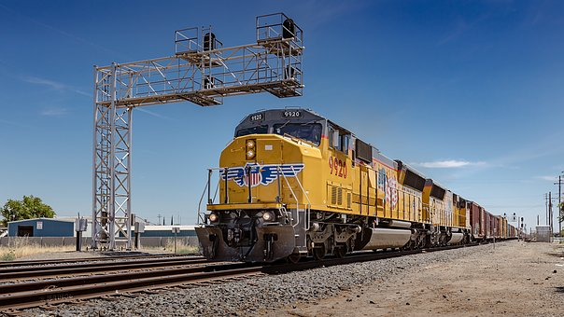
1. Freight trains carry the bulk of loads.

Slide 5
2.__________ trains carry mail.

Slide 6
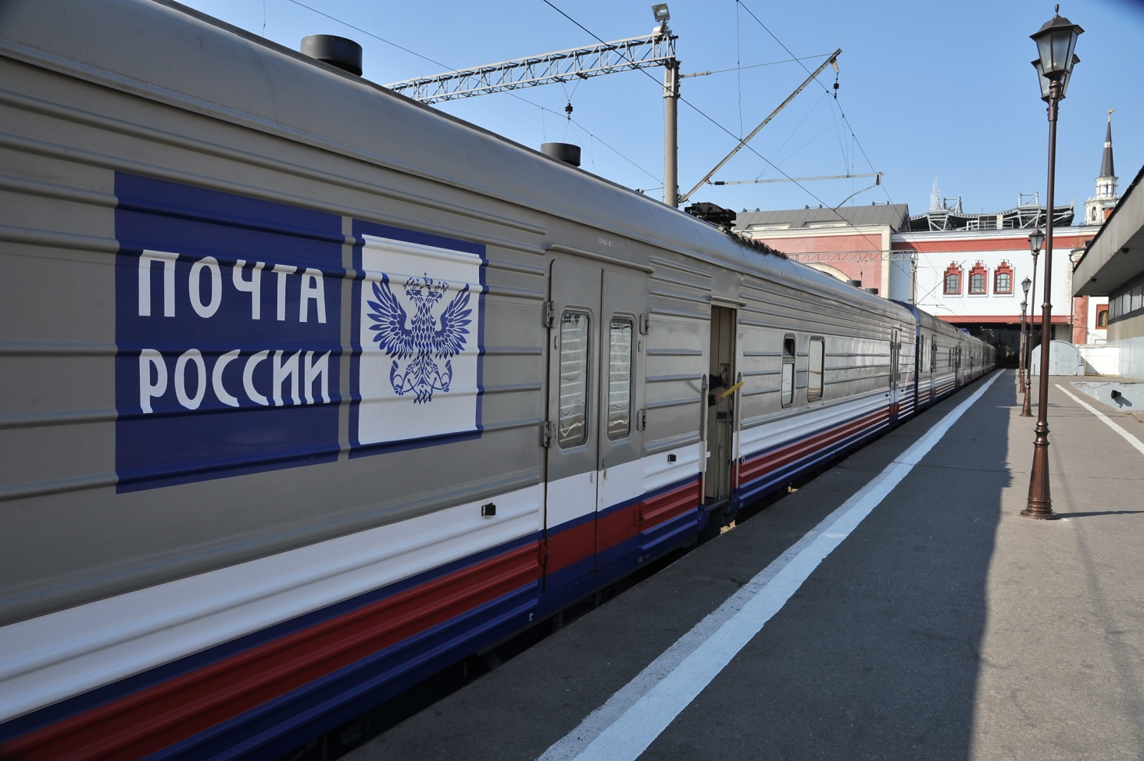
2. Mail trains carry mail.

Slide 7
3. The “Bullet Train” is a name for a______train.

Slide 8
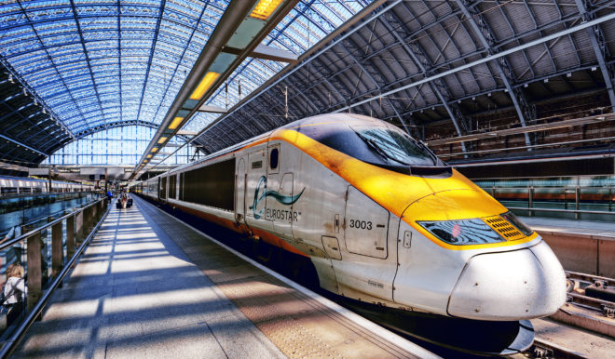
3. The “Bullet Train” is a name for a high-speed train.

Slide 9
4. Railroads operate two main types of ______trains: commuter trains and intercity trains.

Slide 10
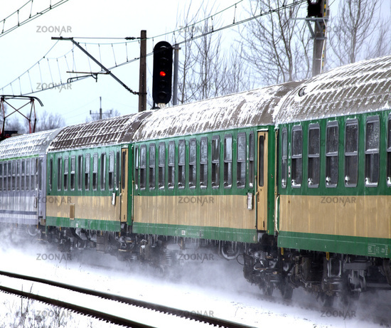
4. Railroads operate two main types of passenger trains: commuter trains and intercity trains.

Slide 11
5. _______trains carry passengers between large cities and the surrounding suburbs.

Slide 12
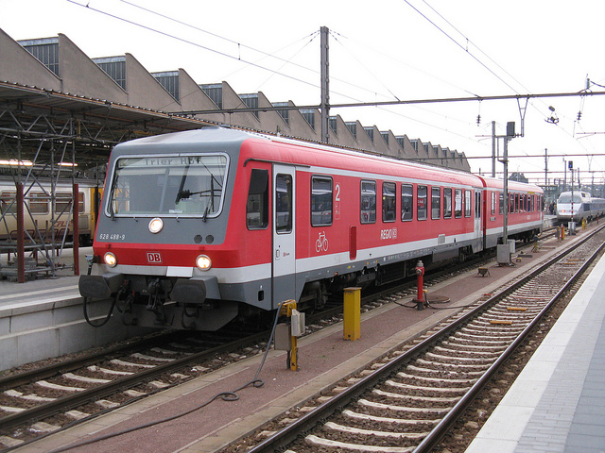
5. Commuter trains carry passengers between large cities and the surrounding suburbs.

Slide 13
6. The longest _______trains cover great distances and take several days to complete.

Slide 14
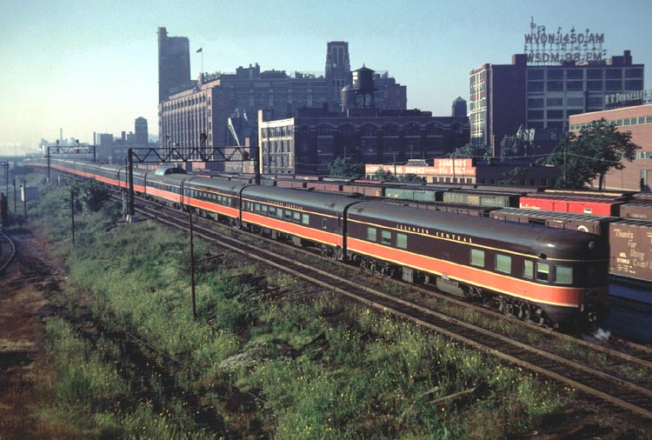
6. The longest intercity trains cover great distances and take several days to complete.

Slide 15
7. Many intercity passenger trains have special ______, such as dining ____ and sleeping ____, in addition to coaches.

Slide 16
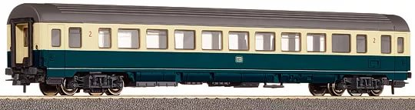
7. Many intercity passenger trains have special cars, such as dining cars and sleeping cars, in addition to coaches.

Slide 17
8. A_______ is another word for a passenger car.

Slide 18
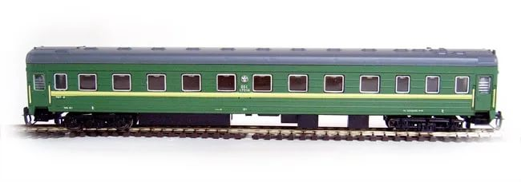
8. A coach is another word for a passenger car.

Slide 19
9. In the 1950’s US railroads introduced _____cars to carry truck trailers.

Slide 20
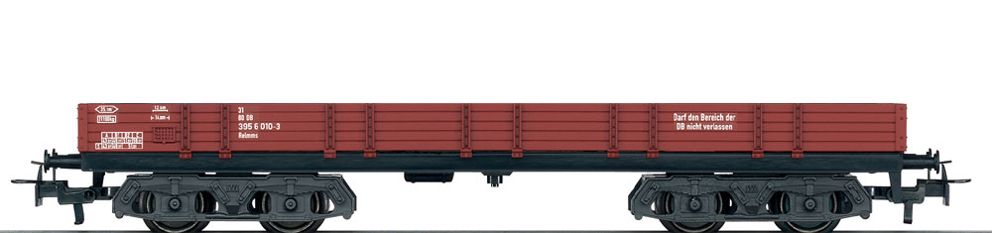
9. In the 1950’s US railroads introduced flat cars to carry truck trailers.

Slide 21
10. _____cars are used to carry coal.

Slide 22
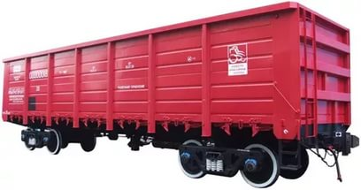
10. Box cars are used to carry coal.

Slide 23
11. Intercity trains consist of _________cars which let passengers to have a sleep in a long journey. They also have __________cars to provide meals for passengers.

Slide 24
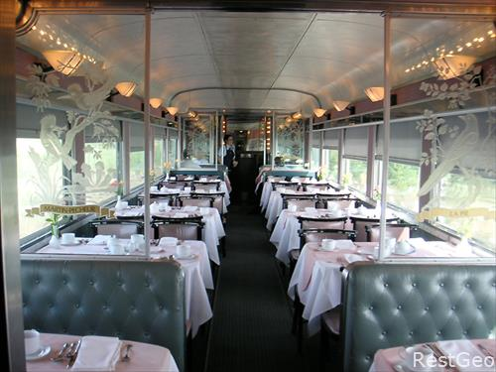
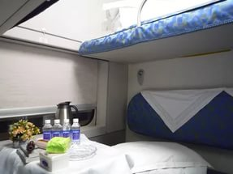
11. Intercity trains consist of sleeping cars which let passengers to have a sleep in a long journey. They also have dining cars to provide meals for passengers.

Slide 25
12._________line routes link major cities.

Slide 26
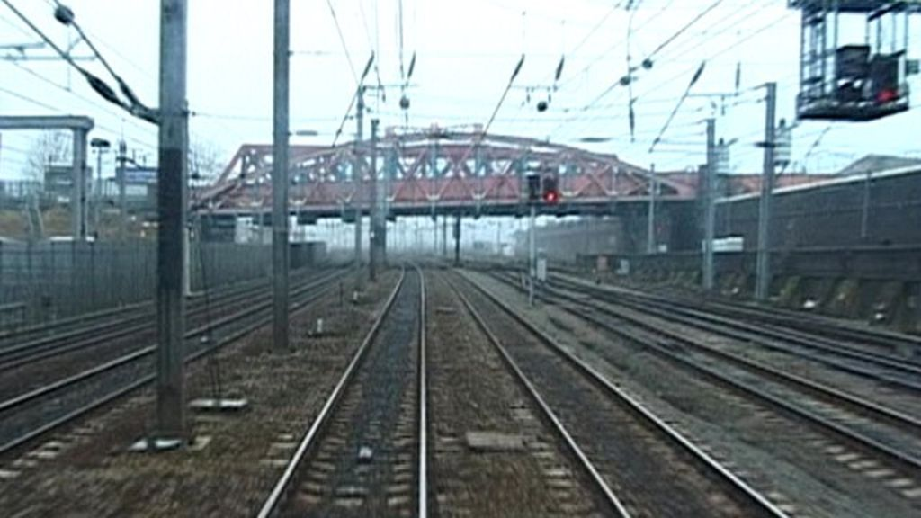
12.Main line routes link major cities.

Slide 27
13.________lines extend between main lines and various places not served by main lines.

Slide 28
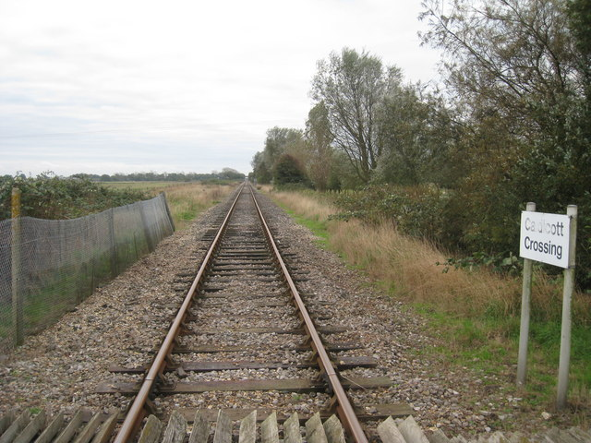
13.Branch lines extend between main lines and various places not served by main lines.

Slide 29
LET’S LEARN SOMETHING NEW

Slide 30
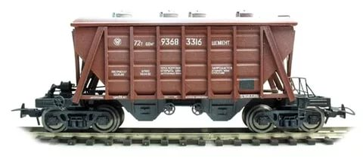
NEW WORDS:
1. hopper – вагон с откидным дном
Covered hopper – крытый вагон с откидным дном
Open top hopper car – открытый вагон с откидным дном

Slide 31
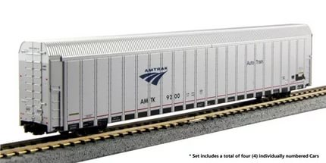
NEW WORDS:
2. autorack – вагон для перевозки
легковых автомобилей

Slide 32
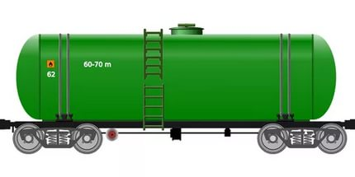
NEW WORDS:
3. tank car – вагон-цистерна
_________________________________
to stack – складывать
vehicle – транспортное средство

Slide 33
FREIGHT TRAINS

Slide 34
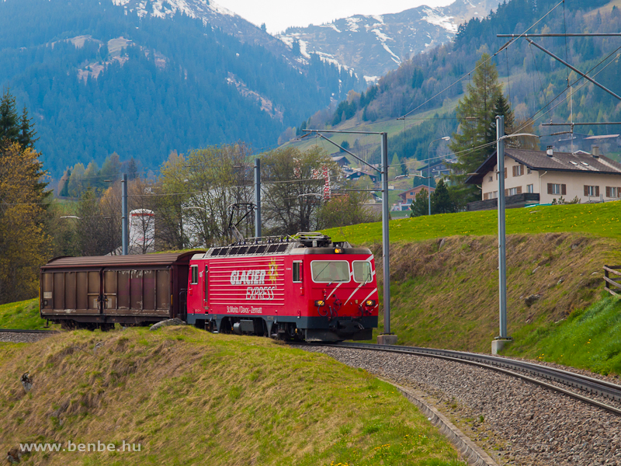
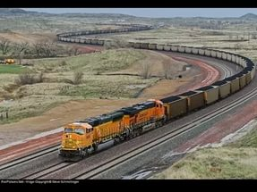
NEW WORDS:
4. local – пригородный поезд
5. mainline freight – грузовой
поезд дальнего следования

Slide 35
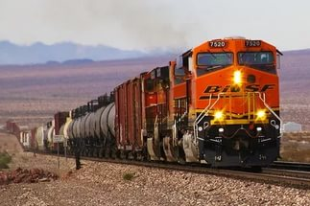
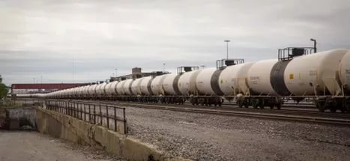
NEW WORDS:
6. mixed freight/ manifest –
грузовой поезд, состоящий
из вагонов разного типа
7. unit train – грузовой поезд,
состоящий из вагонов одного
типа

Slide 36
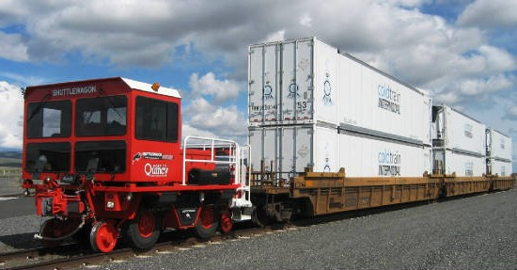
NEW WORDS:
8. intermodal train – интермодальный поезд, специализирующийся на перевозке контейнеров с разным содержимым.

Slide 37
TYPES OF FREIGHT TRAINS
freight trains
mainline freights
manifest / mixed trains
unit trains
locals
intermodal trains

Slide 38
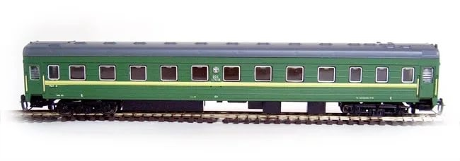
TRUE OR FALSE?
This is a hopper.

Slide 39
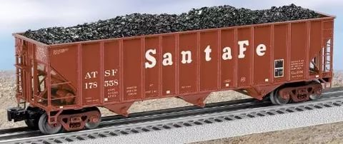
TRUE OR FALSE?
This is a covered hopper.

Slide 40
TRUE OR FALSE?
This is an autorack.

Slide 41
TRUE OR FALSE?
These are tank cars.

Slide 42
TRUE OR FALSE?
It is a mainline freight.

Slide 43
TRUE OR FALSE?
It is a mixed freight.

Slide 44
TRUE OR FALSE?
It is a unit train

Slide 45
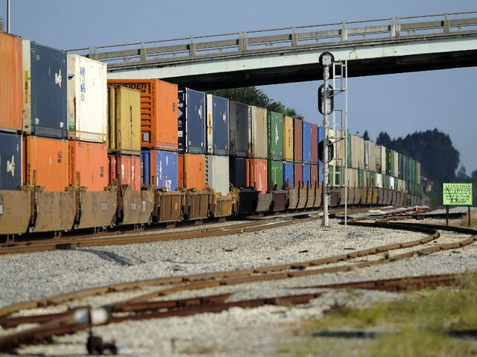
TRUE OR FALSE?
It is an intermodal train.

Slide 46
THE LESSON IS OVER.
THANK YOU FOR YOUR WORK!

