Slide 1
World’s Famous Sportspeople
Известные во всем мире спортсмены

Slide 2
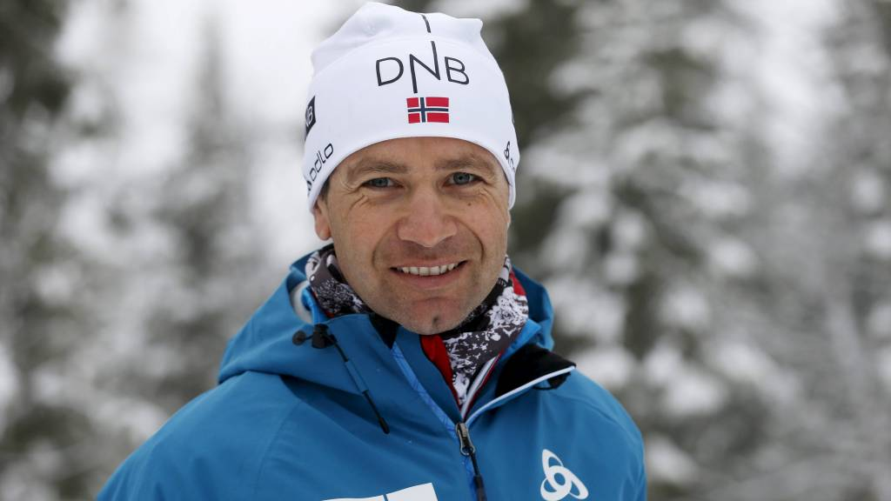
Ole Einar Bjørndalen

Slide 3
Ole Einar Bjørndalen (born 27 January 1974) is a Norwegian professional biathlete, often referred to by the nickname "The King of Biathlon". He is the most medaled Olympian in the history of the Winter Olympic Games, with 13 medals. He is also the most successful biathlete of all time at the Biathlon World Championships, having won 40 medals. He has won the Overall World Cup title six times, in 1997–98, in 2002–03, in 2004–05, in 2005–06, in 2007–08 and in 2008–09, more than any other male biathlete and the same as female record holder Magdalena Forsberg.

Slide 4
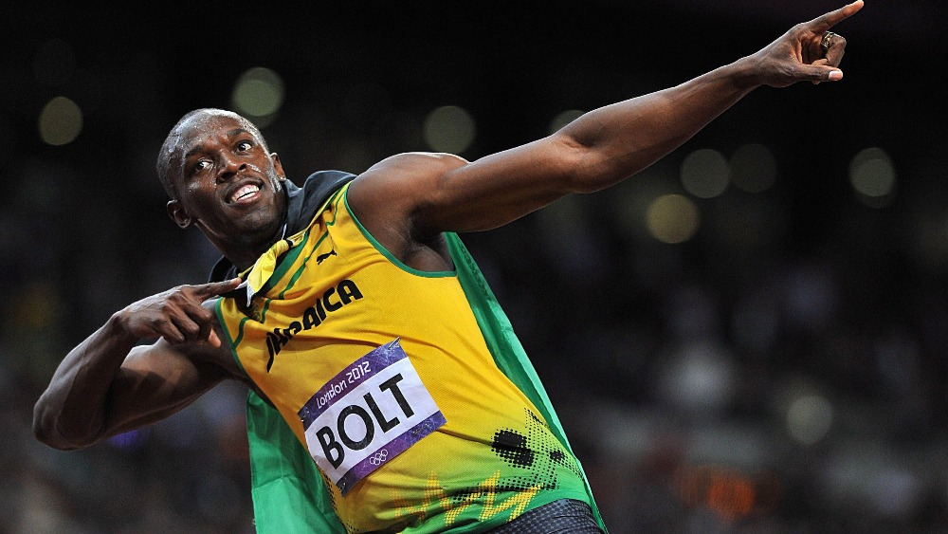
Usain St. Leo Bolt

Slide 5
Usain St. Leo Bolt, (born 21 August 1986) is a Jamaican sprinter. Regarded as the fastest person ever, he is the first man to hold both the 100 metres and 200 metres world records since fully automatic time measurements became mandatory in 1977. Along with his teammates, he also set the world record in the 4×100 metres relay. He is the reigning Olympic champion in these three events, the first man to win six Olympic gold medals in sprinting, and an eleven-time World champion. He was the first to achieve a "double double" by winning 100 m and 200 m titles at consecutive Olympics (2008 and 2012), and topped this through the first "double triple" (including 4×100 m relays). Bolt's achievements in sprinting have earned him the media nickname "Lightning Bolt.

Slide 6
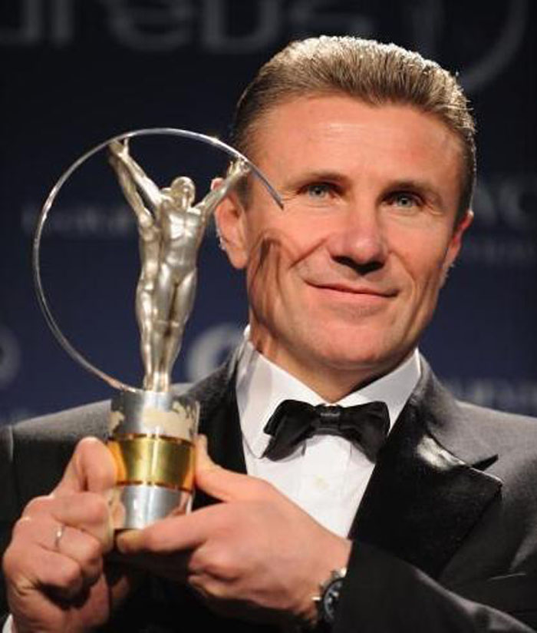
Serhiy Nazarovich Bubka

Slide 7
Serhiy Nazarovych Bubka (born 4 December 1963) is a former Ukrainian pole vaulter. He represented the Soviet Union until its dissolution in 1991, was twice named Athlete of the Year by Track & Field News, and in 2012 was one of 24 athletes inducted as inaugural members of the International Association of Athletics Federations Hall of Fame.
Bubka won six consecutive IAAF World Championships, an Olympic gold medal and broke the world record for men's pole vault 35 times (17 outdoor and 18 indoor records). He was the first pole vaulter to clear 6.0 metres and 6.10 metres.

Slide 8
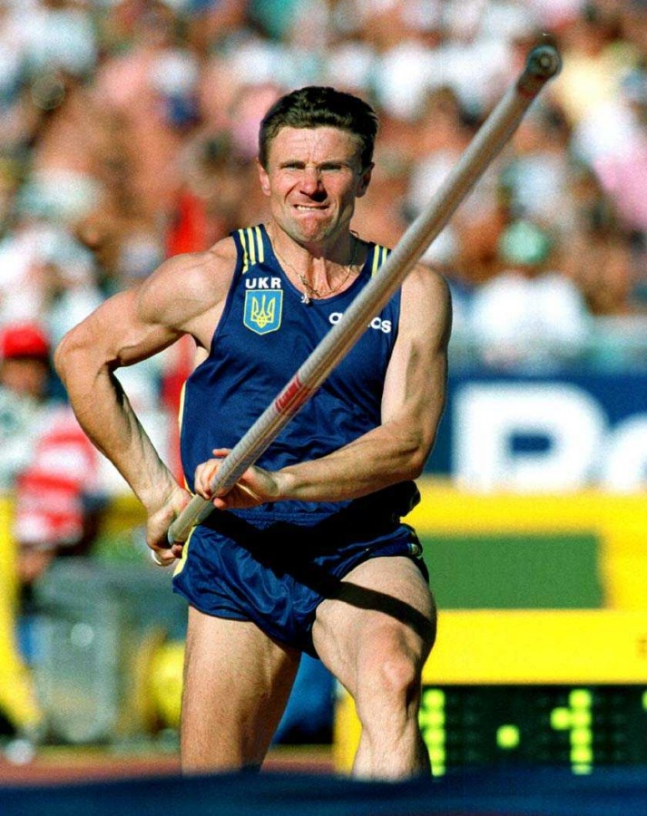

Slide 9
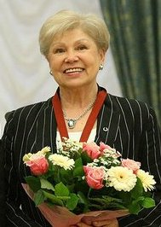

Slide 10
Larisa Semyonovna Latynina
Larisa Semyonovna Latynina ( born 27 December 1934) is a former Soviet gymnast. Between 1956 and 1964 she won 14 individual Olympic medals and four team medals. Her total of 18 Olympic medals was a record for 48 years until surpassed by American swimmer Michael Phelps on 31 July 2012. Although Phelps broke her total medal count record, her record for individual event medals (14) still stands. She is credited with helping to establish the Soviet Union as a dominant force in gymnastics.

Slide 11
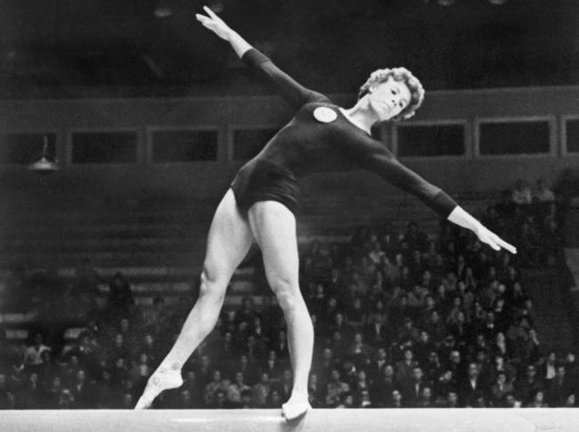

Slide 12
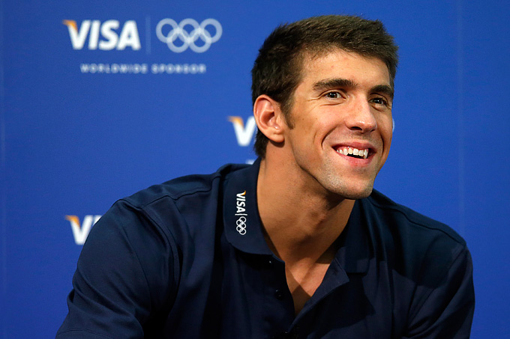
Michael Phelps

Slide 13
Michael Fred Phelps II (born June 30, 1985) is an American competition swimmer and the most decorated Olympian of all time, with a total of 22 medals. Phelps also holds the all-time records for Olympic gold medals (18), Olympic gold medals in individual events (11), and Olympic medals in individual events for a male (13). In winning eight gold medals at the 2008 Beijing Games, Phelps took the record for the most first-place finishes at any single Olympic Games. Five of those victories were in individual events, tying the single Games record.
Phelps is the long course world recordholder in the 100-meter butterfly, 200-meter butterfly and 400-meter individual medley as well as the former long course world recordholder in the 200-meter freestyle and 200-meter individual medley. He has won a total of 77 medals in major international long-course competition, totalling 61 gold, 13 silver, and 3 bronze spanning the Olympics, the World, and the Pan Pacific Championships

