Slide 1
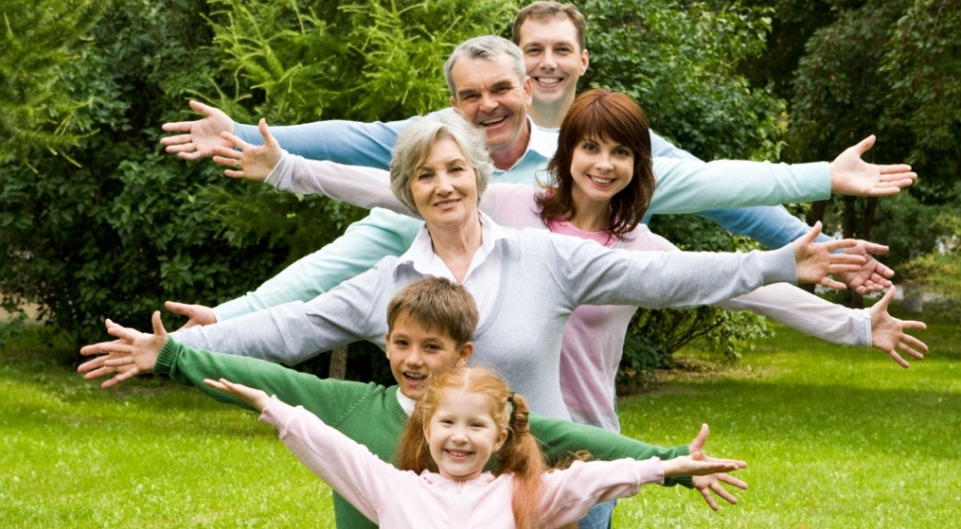

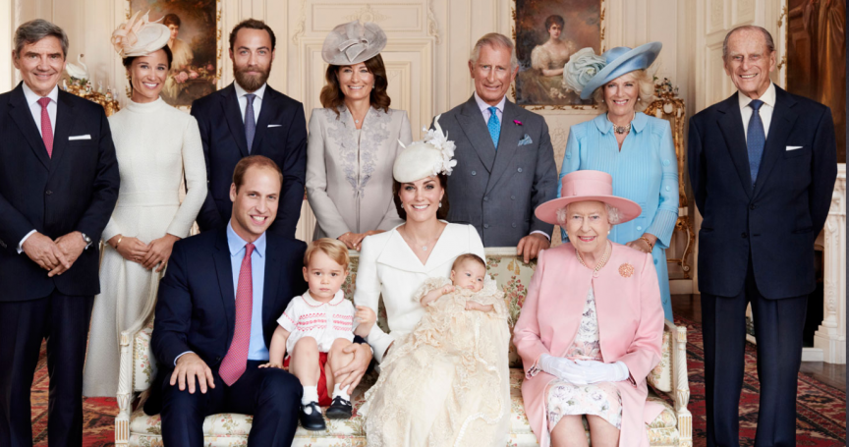
MY FAMILY
ГАПОУ МО "Кандалакшский индустриальный колледж" ​
Храмцова Тамара Владимировна
Кандалакша, 2016​

Slide 2
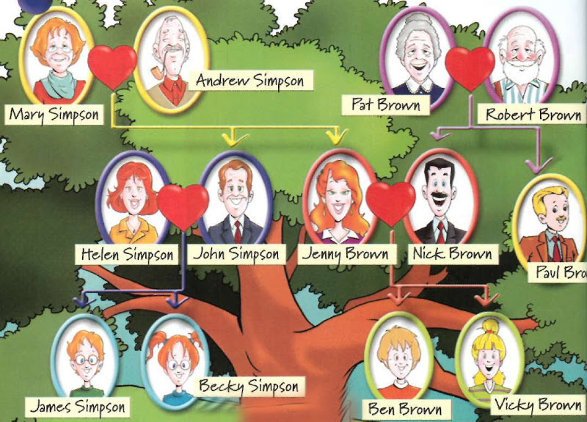

Slide 3
Video 1.
 | NAME | MARITAL STATUS | KIDS | PROFESSION | HOBBY
COUSIN
BROTHER
AUNT
SISTER’S HUSBAND
NEPHEW

Slide 4
Video 1.
 | NAME | MARITAL STATUS | KIDS | PROFESSION | HOBBY
COUSIN
BROTHER
AUNT
SISTER’S HUSBAND
NEPHEW
TEDDY
SINGLE
-
WAITER
ROCK MUSIC
EDDY
MARRIED
TWO KIDS
DOCTOR
CLASSICAL MUSIC
JUDY
DIVORCED
NO KIDS
ARTIST
-
ERNIE
MARRIED
BASEBALL
BASKETBALL
MOVIES
TWO KIDS
ARCITECT
DAVID
-
STUDENT
TRAVELLING JAZZ
SINGLE

Slide 5
Video 1.
 | NAME | MARITAL STATUS | KIDS | PROFESSION | HOBBY
COUSIN | TEDDY | SINGLE | - | WAITER | ROCK MUSIC
BROTHER | EDDY | MARRIED | TWO KIDS | DOCTOR | CLASSICAL MUSIC
AUNT | JUDY | DIVORCED | NO KIDS | ARTIST | -
SISTER’S HUSBAND | ERNIE | MARRIED | TWO KIDS | ARCHITECT | BASEBALL BASKETBALL MOVIES
NEPHEW | DAVID | SINGLE | - | STUDENT | TRAVELLING JAZZ

Slide 6
Video 2
NAMES | WHAT’S COMMON? | WHAT’S DIFFERENT?
CHRIS VS HIS SISTER
DEEPTI VS HER SISTER
ANGELIQUE VS HER BROTHER

Slide 7
Video 2
NAMES | WHAT’S COMMON? | WHAT’S DIFFERENT?
CHRIS VS HIS SISTER
DEEPTI VS HER SISTER
ANGELIQUE VS HER BROTHER
CHRIS IS INTERESTED IN SPORT.
HIS SISTER LIKES THE ART.
THEY LOOK ALIKE
DIPTI LIKES TO SPEND MONEY.
HER SISTER IS MUCH MORE BETTER WITH MONEY THAN DEEPTI.
-
THEY GREW UP IN THE SAME HOUSE
THEY LIKE THE SAME FOOD
THEY LIKE TO LISTEN TO THE SAME MUSIC
ANGELIQUE IS MUCH MORE TALKATIVE.
HER BROTHER IS MUCH MORE SHY.

Slide 8
Video 2
NAMES | WHAT’S COMMON? | WHAT’S DIFFERENT?
CHRIS VS HIS SISTER | THEY LOOK ALIKE | CHRIS IS INTERESTED IN SPORT. HIS SISTER LIKES THE ART.
DEEPTI VS HER SISTER | - | DIPTI LIKES TO SPEND MONEY. HER SISTER IS MUCH BETTER WITH MONEY THAN DEEPTI.
ANGELIQUE VS HER BROTHER | THEY GREW UP IN THE SAME HOUSE THEY LIKE THE SAME FOOD THEY LIKE TO LISTEN TO THE SAME MUSIC | ANGELIQUE IS MUCH MORE TALKATIVE. HER BROTHER IS MUCH MORE SHY.

Slide 9
Video 2
Advantages and disadvantages of a large family
ADVANTAGES | DISADVANTAGES

Slide 10
Video 2
Advantages and disadvantages of a large family
ADVANTAGES | DISADVANTAGES
It’s fun to have a lot of brothers and sisters.
Parents have less time for each child
It’s great to have large family occasions.
Parents have less funds for each child.
It’s very hectic and noisy. You can never have time alone.

Slide 11
Video 2
Advantages and disadvantages of a large family
ADVANTAGES | DISADVANTAGES
It’s fun to have a lot of brothers and sisters.
Parents have less time for each child
It’s great to have large family occasions.
Parents have less funds for each child.
It’s very hectic and noisy. You can never have time alone.

Slide 12
Have you learnt something new?
Yes, I have learnt …
No, I have already known everything.
Do you like the lesson?
I like the lesson, because …
I don’t like the lesson because…
Are you satisfied with you work?
Yes, I am.
No, I am not, because …
THE LESSON IS OVER!
THANK YOU FOR ATTENTION!

Slide 13
Материалы к уроку:
1. Saslow J. Asher A. Top Notch TV Fundamentals. Videos. – Pearson Education Limited, 2006

