Slide 1
Предлоги

Slide 2
Предлоги ВРЕМени: at, on, in
1. Точное время: at
I start work at 8 o’clock
I go to bed at midnight.
2. День: on
I don’t work on Sundays.
I was born on 22 November.
The concert is on New Year’s Day.
3. Месяц/время года/год: in
I’m going on holiday in October
Emma left school in 2013.
The garden is lovely in spring.

Slide 3
предлоги времени: at, on ,in
(Другие употребления )
Нет предлога: this… next…. Last… every…
The garden was lovely last summer.
At | On | In
at the weekend at night at the midnight at Christmas/ at Easter at the end of… at the moment/ at present at sunset/at sunrise at the same time | on Monday morning on Sunday evening on Christmas Day/ on my birthday | in the morning/in the afternoon/ in the evening in five minutes in two years in six weeks in the Middle Ages in the 18th century In the past/ in the future

Slide 4
Другие предлоги времени
1. from… to… - от … до …
I work from Monday to Friday
2. Until/till - до (конца какого-то периода)
They will be away until Friday.
Wait here until I come back.
3. Since – c … (какого-то времени в прошлом)
Мr. and Mrs. Kelly have been married since
1980.
4. For – в течении (какого-то периода времени)
George stayed with us for three days.

Slide 5
Другие предлоги времени (продолжение):
5. before… - до…
Everybody is nervous before exams.
6. after … - после…
We were tired after our visit to museum.
7. В течение:
during + сущ.: We didn’t speak during the meal.
while + гл.: We didn’t speak while we were eating.
for+ период времени: I lived in London for a year.

Slide 6
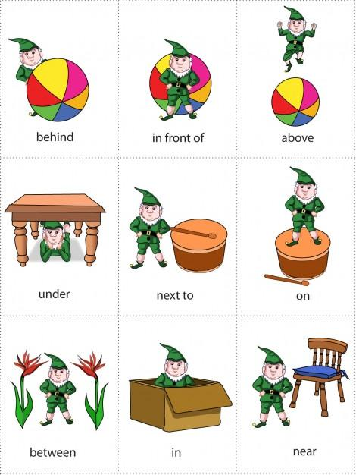
Предлоги места

Slide 7
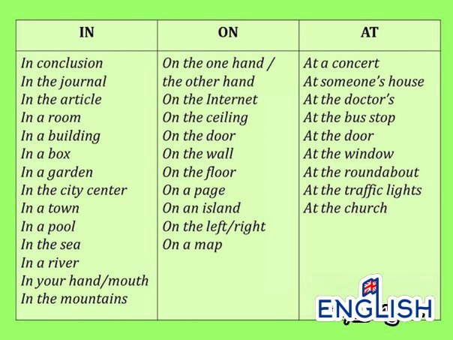
Предлоги места in, on, at:

Slide 8
Предлоги места in, on, at
(Другие употребления ) :
in | on | at
In bed In hospital In prison In a street In the sky In the middle of… In a photograph/ in a picture | On a bus On a train On a ship On a plane On the first floor On the way to…/ on the way home | At the desk/at the table At the top At the bottom At the end of (the street)… At home At work At school At university At college At the station At the airport At Jane’s (house)/ at my sister’s (house) At a party At a football match

Slide 9
Предлог направления to:
The bus is going to London
Emma go to work every day
Но: со словом home предлог to не
используется:
I get/arrive/go home every evening.
(Сравните: I stayed at home yesterday.)

